Slide 1

Quantitative Financial Portfolio Optimization using Quantum Approximation
Batch No. 17
Team Member: Vijayalakshmi S
Register Number: 211420104304
Project Guide: Dr. K. Valarmathi M.E., Ph.D.,
Panimalar Engineering College

Slide 2
1
Abstract
Portfolio optimization is a primary component of the decision-making process in finance, aiming to tactfully allocate assets to achieve optimal returns while considering various constraints.
It is an optimization problem where we have a collection of assets and we want to select these assets that maximize our return but at the same time minimize the risk.
These optimization problems can be formulated as quadratic programs which are well studied classically and are very difficult to solve.
Quantum Mechanics principles native to Quantum Computing, make it suitable for implementing financial systems, also inline with business objectives; reducing execution time adding to higher returns.
Panimalar Engineering College | 2024

Slide 3
2
Introduction
Financial portfolio optimization is the problem of optimal allocation of a fixed budget to a collection of assets (commodities, bonds, securities etc.) which produces random returns over time.
The goal of this process is to essentially ensure that one can acquire the highest amount of profits with reasonable risk tolerance.
Aim of
Portfolio Optimization:
• Maximize returns
• Minimize risk
• Stay within budget
Input
• Uniform random historical price data
• Budget
• Risk tolerance
Output
• A portfolio representing a list of investments and the expected return
Panimalar Engineering College | 2024

Slide 4
3
Existing System
Investors(J P Morgan Chase, Vanguard Group, Charles Schwab etc.) in multiple fields such as banks, artmobiles, etc., need to conduct portfolio optimization and use methods like:
GRG Nonlinear Solver:
GRG stands for “Generalized Reduced Gradient.” Solver is a Microsoft Excel add-in program; can find an optimal (maximum or minimum) value for a formula in one cell — called the objective cell — subject to constraints, or limits, on the values of other formula cells on a worksheet.
Classical Machine Learning:
Using the Efficient Frontier Theory formulated by Harry Markowitz in 1952, an intelligent set of smart models for portfolio optimization were constructed.
These models process the quantitative data inputs, analyze them, and produce an efficient allocation of capital.
Panimalar Engineering College | 2024

Slide 5
4
Drawbacks
GRG Nonlinear Solver
Highly dependent on initial condition.
Solution obtained may not be the global optimum.
Most likely to return the local optimum value nearest to the initial conditions.
Having a large number of dimensions in the feature space can dramatically impact the performance of machine learning algorithms, especially in the real-time environment.
Therefore, many algorithms of dimensionality reduction and features selection are used on the original dataset to reduce the number of input features.
Panimalar Engineering College| 2024
Classical Machine Learning
Large datasets are common and are difficult to interpret.
Higher execution time.

Slide 6
5
Proposed System
The problem of portfolio optimization can be represented as finding a way to minimize a given cost function that is related to the risk taken when choosing an asset.
The proposed system thus updates the weight associated with each asset in order to obtain a portfolio that has lower risk with high gain.
Using Quantum Approximate Optimization Algorithm (QAOA), we solve the combinatorial problem of handling vast feature dimension and obtain optimum solution against various constraints.
Panimalar Engineering College | 2024

Slide 7
6
Advantages
1
High Performance Computing:
The high speed processing power helps reduce the execution time required to process the data.
Panimalar Engineering College| 2024
Effective Handling of Large Datasets:
It is possible to process datasets with high dimensions in the feature space and huge amounts of data.
2
3
Acquire Optimal Return:
It helps achieve the optimal returns against various constraints unlike existing systems which are likely to return local optimum.

Slide 8
7
﻿Literature Survey
S. No. | Year | Title | Method | Limitation
1. | 2023 | A Deep Neural Network Algorithm for Linear-Quadratic Portfolio Optimization With MGARCH and Small Transaction Costs | Reinforcement Learning using multivariate generalized autoregressive conditional- heteroskedasticity(MGARCH) | Applicable only for small transactions. Scaled down feature dimensions.
2. | 2024 | Empirical Analysis of Quantum Approximate Optimization Algorithm for Knapsack-based Financial Portfolio Optimization | Knapsack Algorithm used to find complexity and QAOA is used to find the optimal solution | Model yields only 50% result in noisy conditions.
3. | 2023 | Quantum-inspired Computing: Entanglement-enhanced Technique for Short Portfolio in Global Markets | QIO based portfolio optimization | Model unstable with higher data input.
4. | 2023 | Reinforcement Learning for Stock Prediction and High-Frequency Trading With T+1 Rules | Classical learning approach using inverse reinforcement learning, and multi-armed bandit learning. | Higher execution time.
Panimalar Engineering College | 2024

Slide 9
8
﻿Literature Survey
S. No. | Year | Title | Method | Limitation
5. | 2023 | Trend Ratio-based Portfolio Optimization Model Adopting Entanglement-enhanced Quantum-inspired Evolutionary Computation in the Global Financial Markets | Quantum Inspired Optimization using Local and Global Search | Only finds critical areas in trends, limited application over dataset.
6. | 2023 | Real-Time Portfolio Management System Utilizing Machine Learning Techniques | Classical approach using K-means algorithm and metaheuristics algorithm | Model can not handle high dimension feature selection
7. | 2023 | Deep reinforcement learning for stock portfolio optimization by connecting with modern portfolio theory | Classical approach using reinforcement learning and modern portfolio theory | Higher execution time.
8. | 2023 | Multi-qubit quantum computing using discrete-time quantum walks on closed graphs | Quantum walk model based on Grover’s algorithm | Applicable only for closed graphs
Panimalar Engineering College | 2024

Slide 10
9
﻿Literature Survey
S. No. | Year | Title | Method | Limitation
9. | 2023 | Application of quantum computing in discrete portfolio optimization | Quantum Walk Optimization Algorithm used for portfolio optimization | Can not handle high dimension feature selection.
10. | 2021 | Quantum Optimization Heuristics with an Application to Knapsack Problems | QAOA used for finding greedy solutions | QAOA used for finding greedy solutions
11. | 2021 | PyPortfolioOpt: portfolio optimization in Python | Portfolio optimization using classical mean-variance optimization | Low throughput and high execution time
12. | 2020 | OSQP: an operator splitting solver for quadratic programs | Quadratic conversion of solver | Not applied to financial portfolios
Panimalar Engineering College | 2024

Slide 11
10
﻿Literature Survey
S. No. | Year | Title | Method | Limitation
13. | 2019 | Improving Variational Quantum Optimization using CVaR | Combinational Optimization using Variational Quantum Eigen solver | Not applied to financial portfolios.
14. | 2019 | Quantum computing for finance: overview and prospects | Research on QML techniques against classical methods | -
15. | 2015 | A Quantum Approximate Optimization Algorithm Applied to a Bounded Occurrence Constraint Problem | QAOA | Not applied for portfolio optimization.
16. | 2011 | Monte Carlo estimation of value-at-risk, conditional value-at-risk and their sensitivities | Classical approach using Monte Carlo simulation | Limited application
Panimalar Engineering College | 2024

Slide 12
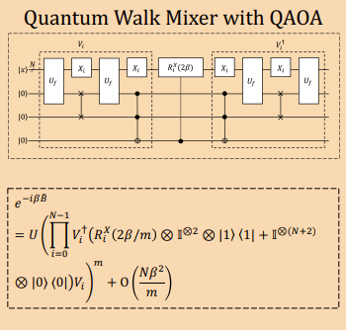
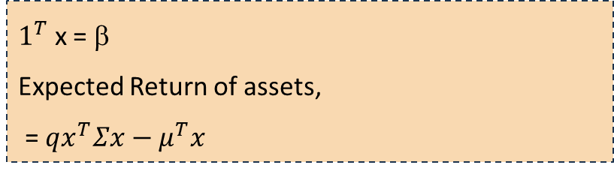


Architecture
11
Input
(Stock Prices Over a Period of Time)
Portfolio Preprocessing
Mean-Variance Portfolio Modeling
Daily Return ($R_{i}$)
Expected Return Calculation
Weight of each Stock ($W_{i}$)
Panimalar Engineering College| 2024
Expected Returns(E(R))
Quantum Approximation Optimizer
Data Processing Model
Forget Gate Layer
Update Layer Gate
Output Gate Layer
$1^{T}$ x = β
Expected Return of assets,
= $qx^{T}Σx−μ^{T}x$
Output
(Optimal Solution)

Slide 13






12
System Requirements
Software Requirements:
Platform: Jupyter Notebook
Libraries: Numpy, Pandas, SciPy, Scikit Learn, Qiskit QASM Simulator
Programing Language: Python 3.7 =< 3.9
Panimalar Engineering College| 2024
Hardware Requirements:
Processor: 12th Gen Intel(R) Core(TM) i7-1250U 1.10 GHz
System type: 64-bit operating system, x64-based processor
RAM: 16.0GB

Slide 14
13
Block Diagram
Input
Exploratory Data Analysis
Data Pipe
Data Processing Module
Quantum Approximate
Optimizer
Data Pre-processing
Output
Panimalar Engineering College | 2024

Slide 15
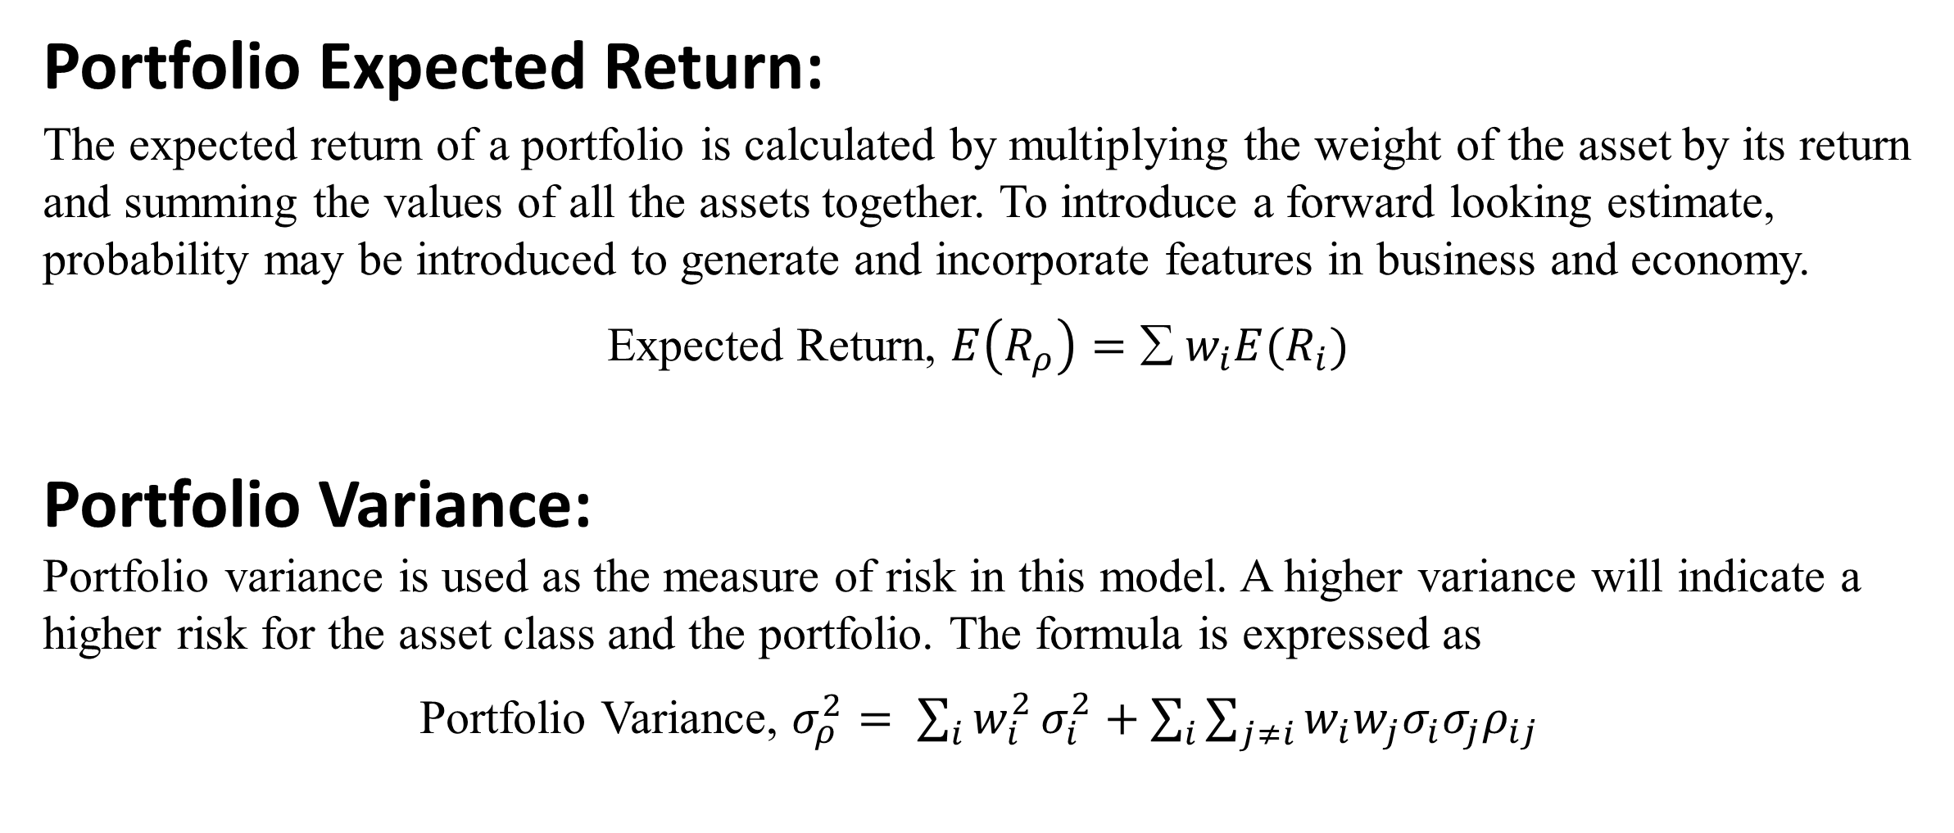
14
Algorithms Used
Portfolio Expected Return:
The expected return of a portfolio is calculated by multiplying the weight of the asset by its return and summing the values of all the assets together. To introduce a forward looking estimate, probability may be introduced to generate and incorporate features in business and economy.
Expected Return, $E\left(R_{ρ}\right)=∑ w_{i}E(R_{i})$
Portfolio Variance:
Portfolio variance is used as the measure of risk in this model. A higher variance will indicate a higher risk for the asset class and the portfolio. The formula is expressed as
Portfolio Variance, $σ_{ρ}^{2}= \sum_{i}{w_{i}^{2}}σ_{i}^{2}+\sum_{i}{\sum_{j≠i}{w_{i}w_{j}σ_{i}σ_{j}ρ_{ij}}}$
Panimalar Engineering College | 2024

Slide 16
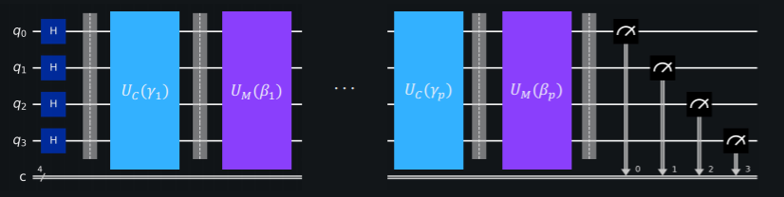

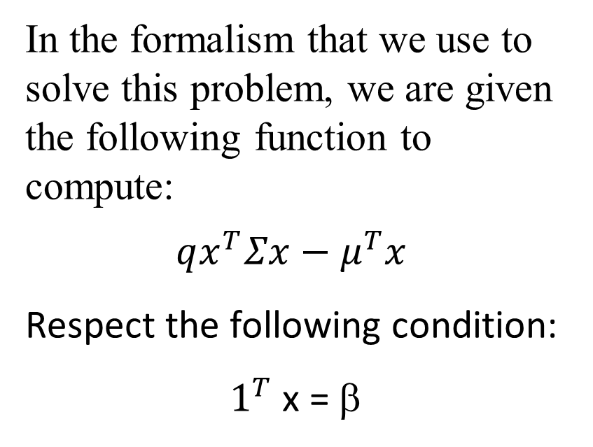
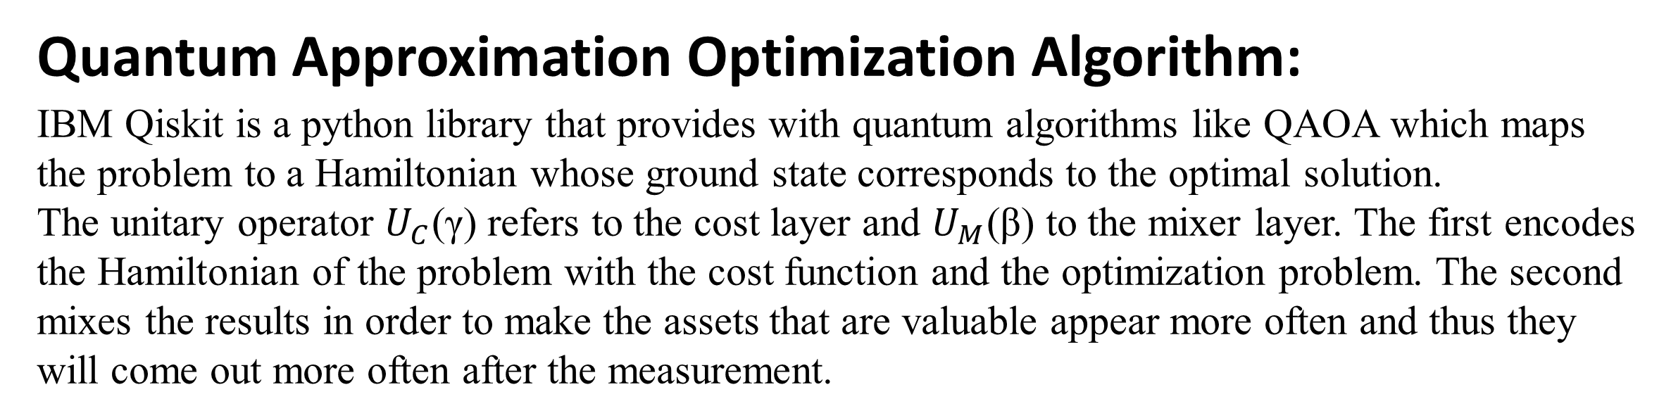
15
Algorithms Used
Quantum Approximation Optimization Algorithm:
IBM Qiskit is a python library that provides with quantum algorithms like QAOA which maps the problem to a Hamiltonian whose ground state corresponds to the optimal solution.
The unitary operator $U_{C}$(γ) refers to the cost layer and $U_{M}$(β) to the mixer layer. The first encodes the Hamiltonian of the problem with the cost function and the optimization problem. The second mixes the results in order to make the assets that are valuable appear more often and thus they will come out more often after the measurement.
In the formalism that we use to solve this problem, we are given the following function to compute:
$$qx^{T}Σx−μ^{T}x$$
Respect the following condition:
$1^{T}$ x = β
Panimalar Engineering College | 2024

Slide 17
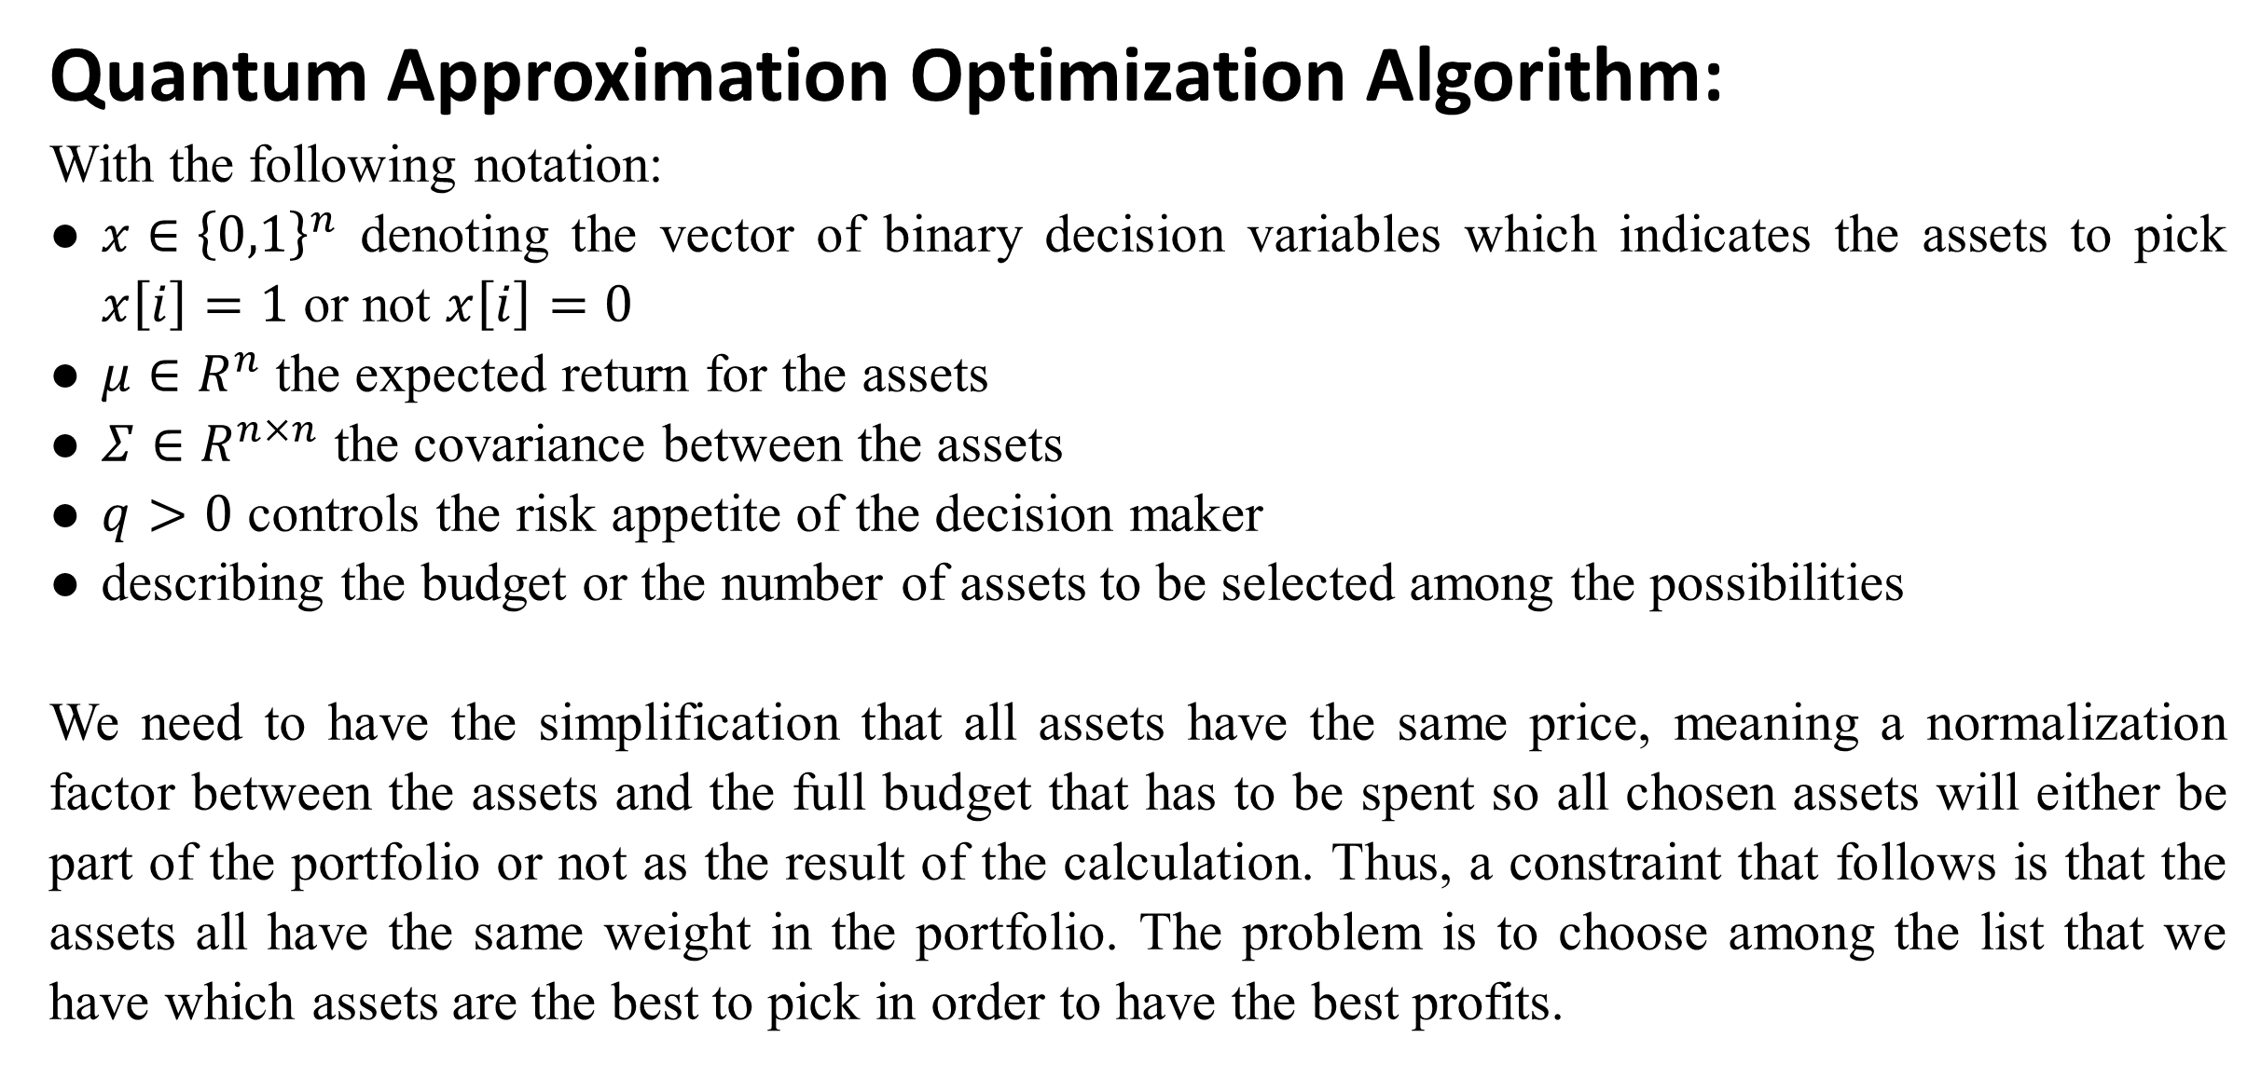
16
Algorithms Used
Quantum Approximation Optimization Algorithm:
With the following notation:
$x∈{\left\{0,1\right\}}^{n}$ denoting the vector of binary decision variables which indicates the assets to pick $x\left[i\right]=1$ or not $x\left[i\right]=0$
$μ∈R^{n}$ the expected return for the assets
$Σ∈R^{n×n}$ the covariance between the assets
$q>0$ controls the risk appetite of the decision maker
describing the budget or the number of assets to be selected among the possibilities
We need to have the simplification that all assets have the same price, meaning a normalization factor between the assets and the full budget that has to be spent so all chosen assets will either be part of the portfolio or not as the result of the calculation. Thus, a constraint that follows is that the assets all have the same weight in the portfolio. The problem is to choose among the list that we have which assets are the best to pick in order to have the best profits.
Panimalar Engineering College | 2024

Slide 18
17
﻿Working
The System works as follows:
Data Acquisition: the quantitative financial data is collected and given as input in csv format to the system.
Exploratory Data Analysis: the collected data is analyzed and null values are found and removed if present.
Data Pipe: the input raw data is converted into a time series of the prices.
Data Processing Module: in accordance to the portfolio vector memory the raw data is processed to find the portfolio value of each agent.
Quantum Approximate Optimizer: the quadratic problem is defined and the quantum circuits find the portfolio weights returning the optimum solution.
Panimalar Engineering College | 2024

Slide 19
18
﻿Module Description
Data Pre-processing Module:
The basic information is explored.
The data is checked for null values and cleaned if present.
The tickers are set for the portfolios of Tesla, Bank of America Corporation(BAC), International Business Machines(IBM), Exxon Mobil Corp.(XOM), and Pfizer Inc.(PFE).
For each stock, the input is a raw time series of the prices (High, Low, Open, Close). The output is a matrix of 4 rows and n (number of available data points) columns.
Panimalar Engineering College | 2024

Slide 20
19
﻿Module Description
Data Processing Module:
The parameters are set for the agent.
The environment is created for the trading agent.
The actor is defined and the trading cost and trading interest is calculated.
The agent portfolio value and the baseline value is found.
Quantum Approximate Optimizer:
The covariance is calculated.
The weight of the assets are added
The portfolio optimum and risks are returned.
Panimalar Engineering College | 2024

Slide 21
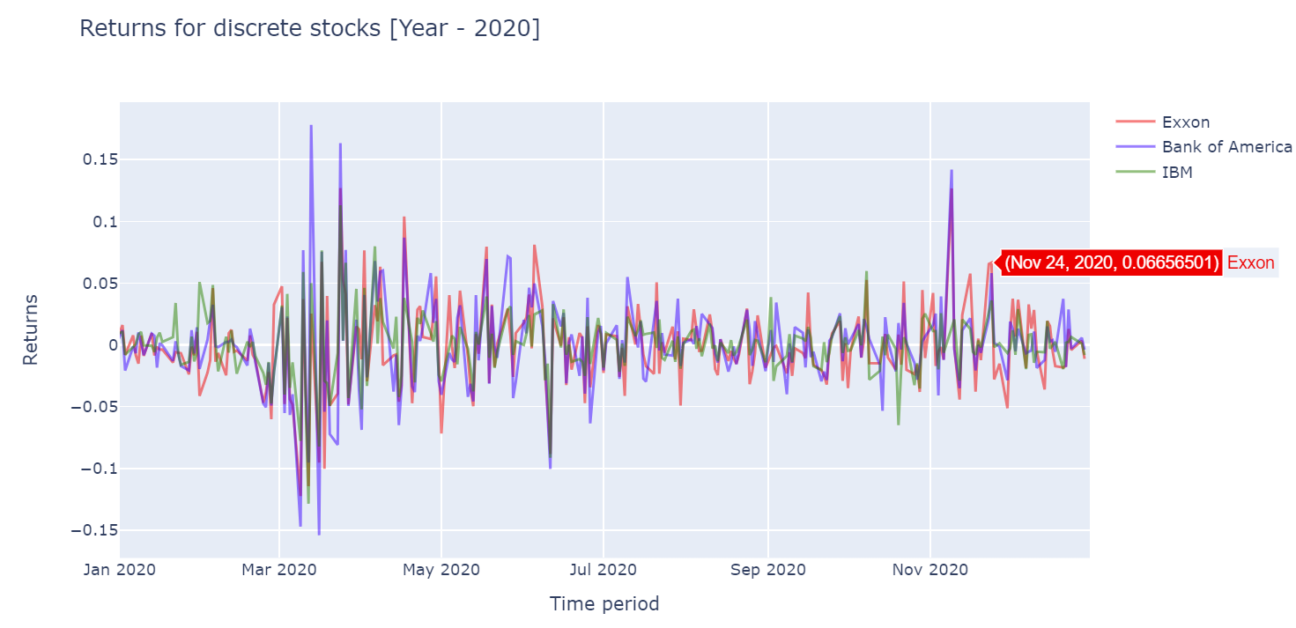
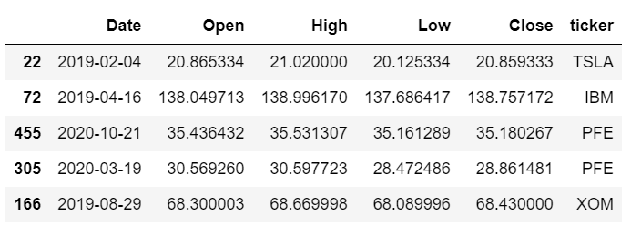
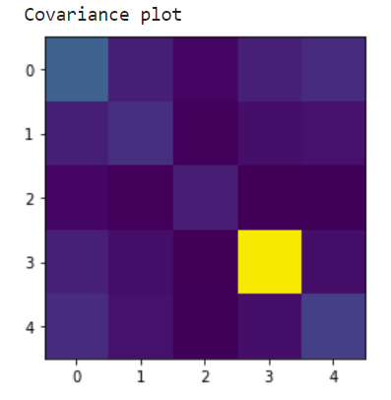
20
Output
The data is analyzed and the pre-processing is complete.
The covariance is calculated for the calculated returns of the various tickers.
The returns for the assets are calculated.
The optimum selection is returned.
Panimalar Engineering College | 2024

Slide 22
21
Results and Conclusion
The result is a portfolio where we divide all the budget into the different chosen assets. The weights are thus equally shared among the assets that were found relevant at the end of the QAOA calculations.
We obtain the final optimal selection for QAOA based on the scope of the study which corresponds to a portfolio with 50% on Exxon and 50% on Tesla.
In conclusion, Quantum Machine-Learning is a viable solution to take into account when talking about this optimization problem.
Panimalar Engineering College | 2024

Slide 23
22
Recommendation
Migrating to Quantum Systems:
The current systems runs on classical computers, migrating the system to a quantum computing environment will improve the system efficiency.
Integration with Big Systems:
The system has capacity to handle big data integration which will improve the system throughput.
Market Volatility:
The financial market is volatile in nature and maybe subjected to unexpected changes beyond available scope.
Panimalar Engineering College | 2024

Slide 24
References
23
[1] Roman Orus, Samuel Mugel, Enrique Lizaso, Quantum computing for finance: overview and prospects,(2024) arXiv preprint https://arxiv.org/abs/1807.03890
[2] E. Campbell, A. Khurana, and A. Montanaro, Applying quantum algorithms to constraint satisfaction problems, Tech. Rep. (2018) arXiv:1810.05582v1.
[3] N. Moll, P. Barkoutsos, L. S. Bishop, J. M. Chow, A. Cross, D. J. Egger, et al., Quantum optimization using variational algorithms on near-term quantum devices, Quantum Science and Technology 3, 030503 (2018).
[4] Gavin E Crooks. Performance of the quantum approximate optimization algorithm on the maximum cut problem. arXiv preprint arXiv:1811.08419, 2018. URL https:// arxiv.org/abs/1811.08419.
[5] Junkyu Jang, NohYoon Seong, Deep reinforcement learning for stock portfolio optimization by connecting with modern portfolio theory, ScienceDirect(2023), https://doi.org/10.1016/j.eswa.2023.119556
[6] Yu-Chi Jiang, Yun-Ting Lai, et al., Quantum-inspired Computing: Entanglement-enhanced Technique for Short Portfolio in Global Markets, IEEE Xplore (2023), DOI: 10.1109/NANO58406.2023.10231234
[7] Hao Fu, Prashanth Krishnamurthy, et al., A Deep Neural Network Algorithm for Linear-Quadratic Portfolio Optimization With MGARCH and Small Transaction Costs, IEEE Xplore (2023), DOI: 10.1109/ACCESS.2023.3245570
[8] Weipeng Zhang, Tao Yin, et al., Reinforcement Learning for Stock Prediction and High-Frequency Trading With T+1 Rules, IEEE Xplore (2023), DOI: 10.1109/ACCESS.2022.3197165
[9] Prakash K. Aithal; M. Geetha, et al., Real-Time Portfolio Management System Utilizing Machine Learning Techniques, IEEE Xplore (2023), DOI: 10.1109/ACCESS.2023.3263260
[10] Schäfer LE, Dietz T, Barbati M, Figueira JR, Greco S, Ruzika S The binary knapsack problem with qualitative levels. European Journal of Operational Research 289(2):508–514, (2021) https://doi.org/10.1016/j.ejor. 2020.07.040
[11] Shunza J, Akinyemi M, Yinka-Banjo C (2023) Application of quantum computing in discrete portfolio optimization. Journal of Management Science and Engineering https: //doi.org/10.1016/j.jmse.2023.02.001
[12] Speidell LS, Miller DH, Ullman JR (1989) Portfolio optimization: A primer. Financial Analysts Journal 45(1):22– 30, https://doi.org/10.2469/faj.v45.n1.22
[13] Zhou L, Wang ST, Choi S, Pichler H, Lukin MD (2020) Quantum approximate optimization algorithm: Performance, mechanism, and implementation on near-term devices. Phys Rev X 10:021067, https://doi.org/10.1103/ PhysRevX.10.021067
[14] Yu-Chi Jiang, Ming-Ho Chang, et al., Trend Ratio-Based Portfolio Optimization Model Adopting Entanglement-enhanced Quantum-Inspired Evolutionary Computation in the Global Financial Markets, IEEE(2023), DOI: 10.1109/CEC53210.2023.10254025
[15] Crooks GE (2018) Performance of the quantum approximate optimization algorithm on the maximum cut problem. arXiv preprint arXiv:181108419 https://doi.org/10. 48550/arXiv.1811.08419
[16] Tae-Kyung Kim, Youngsun Han, et al., Empirical Analysis of Quantum Approximate Optimization Algorithm for Knapsack-based Financial Portfolio Optimization, (2024) arXiv preprint https://arxiv.org/abs/2402.07123
[17] IBM Qiskit Ecosystem, Portfolio Optimization, https://qiskit-community.github.io/qiskit-finance/tutorials/01_portfolio_optimization.html
Panimalar Engineering College | 2024

Slide 25
THANK YOU

